Slide 1
CAR PRICE PREDICTION PROJECT
SUBMITTED BY:
ATISH KALANGUTKAR

Slide 2
Contents
Introduction
Problem Statement
Problem Understanding
What is used car price?
Benifits of buying used cars
Data Analysis & Model Building Flowchart
Exploratory Data Analysis (EDA)
Visualizations
Data Analysis Steps Done
Model Building
Hyper Parameter Tuning and Creating Final Model
Saving the model and prediction results
Conclusion

Slide 3
INTRODUCTION
Used car price prediction is a thing which is very hard to guess as there are many factors which influence the price of the car in the second-hand market.
As the prices changes according to the brand, model, fuel type, km, gear type and the age of the car. All this factors plays an important role in deciding the price of the used car.
Beside this will have to look upon the car history also whether the car has been in the accident or not, whether there any external damage or not, have to check the working condition of the car. And this days most of the people are going for automatic cars and electric cars.
So here we are trying to help the client who sell used cars to understand the price of the used cars by deploying machine learning models.
These models would help the client/sellers to understand the used car market and accordingly they would be able to sell the used car in the market.

Slide 4
Problem Statement
With the covid 19 impact in the market, we have seen lot of changes in the car market. Now some cars are in demand hence making them costly and some are not in demand hence cheaper.
One of our clients works with small traders, who sell used cars. With the change in market due to covid 19 impact, our client is facing problems with their previous car price valuation machine learning models. So, they are looking for new machine learning models from new data. We have to make car price valuation model.
BUSINESS GOAL:
The main aim of this project is to predict the price of used car based on various features. Machine Learning is a field of technology developing with immense abilities and applications in automating tasks. So, we will deploy an ML model for car selling price prediction and analysis. This kind of system becomes handy for many people. This model will provide the approximate selling price for the car based on different features like fuel type, transmission, price, weight, running in kms, engine displacement, milage etc and this model will help the client to understand the price of used cars.

Slide 5
What is used car price?
A used car, a pre-owned vehicle, or a secondhand car, is a vehicle that has previously had one or more retail owners.
Used cars are sold through a variety of outlets, including franchise and independent car dealers, rental car companies, buy here pay here dealerships, leasing offices, auctions, and private party sales.
Some car retailers offer "no-haggle prices," "certified" used cars, and extended service plans or warranties.
Depreciation levels of vehicles differ a lot in exporting and importing countries due to differences in income levels.
The price of a vehicle depreciates faster in high-income countries than in low-income countries.
Used vehicles sellers in high-income countries can thus sell their used vehicles for a higher price in low-income countries. This is the incentive to export used vehicles

Slide 6
Benifits of buying used cars
Buying a Used Car Saves You Money
Bulk of Depreciation Has Already Occurred
No Exaggerated Fees
Lower Customization Costs
Certified and Thoroughly Inspected
Warranties
Warranties
Better for the Environment
Lower Annual Registration Fees
Used cars are way more affordable than a brand new vehicle

Slide 7



Data Analysis And Model Building Flow Chart
Import Libraries
Import Collected Dataset
Data Preprocessing
Label Encoder
Visualizations
(EDA)
Feature Engineering
Checking Correlation
Identifying
Outliers and Skewness
Model Building
Saving the Model & Predictions
Hyper Parameter Tuning
R2 score & Evaluation Metrics

Slide 8
Exploratory Data Analysis (EDA)
Importing required libraries and loading the dataset.
Checked some statistical information such as shape of the dataset,unique values and number of unique values present, type of data present in the columns etc.
Checked for null values and found that there were about 553 null values present in the column Transmission. Further dropped the null values from the dataset.
Also there was one unwanted column named Unnamed:0 which was dropped as it was just having numerical values which was irrelevant at the time of prediction.
Done feature engineering on target variable that is ‘Price’ and also on features that is ‘kms driven’ as it was having commas in between the numbers and rupees sign was there, because of that it was showing data type as object. So replaced them by empty spaces and converted the data type to integer.
Also done feature engineering on column Model in which square brackets and single quotation was present. So replaced them by empty spaces.
While checking for duplicates it was found that there were 18 duplicates present in the dataset. Further it was dropped from the dataset.

Slide 9
Exploratory Data Analysis (EDA) Cont..
While checking for unique values of column Transmission it was found that it was having unique values Manual, Automatic and MAnual. As Manual and MAnual are same. So replaced MAnual with Manual.
While checking for unique values of column owners it was found that it was having values 1st owner, 2nd owner and 3rd owner. As it was an string data type column replaced 1st with First, 2nd with Second and 3rd with Third.
Than separated categorical and numeric features according to the data types.
Performed uni-variate, bi-variate and multi-variate analysis by plotting Dist plot, Count plot, Pie plot, Bar plot and Line plot.
Than checked for Top 50 highest priced cars from the dataset.
Encoded the categorical features by using Label encoded method.
Used bar plot to check the correlation between the features and the label and after with the help of heatmap checked whether there is multicollinearity present or not among the features. So found that there was no multicollinearity problem within the features.
Checked whether there are any outliers present or not using box plot on numerical data columns and found that in column year and kms driven was having outliers so by using z-score method removed outliers.
Checked for skewness on numerical data columns and found that column year was having skewness, so by using power transform method treated the skewness of that particular columns.

Slide 10
Exploratory Data Analysis (EDA) Cont..
Separated feature and label data and than feature scaling was done by using power transform method to avoid any kind of data biasness.
After plotting heatmap, it was seen than there was no multicollinearity problem within the features, but just to cross verify vif method was used. After using vif method it was found that all the columns values were below 5. So it was confirmed that there was no multicollinearity problem within the features.

Slide 11
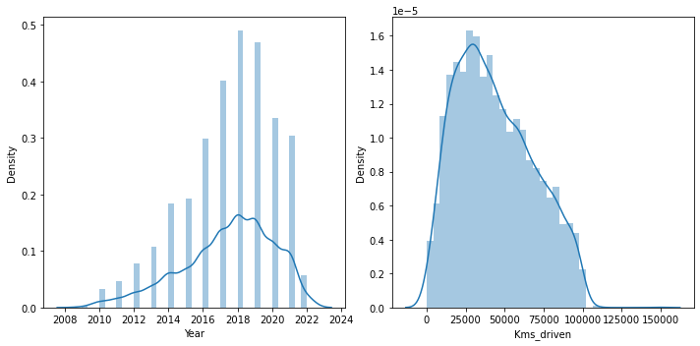
Visualization
By looking at the plots we can see that:
outliers may be present in both the columns and it was seen that skewness is present in column year.
Dist plots

Slide 12
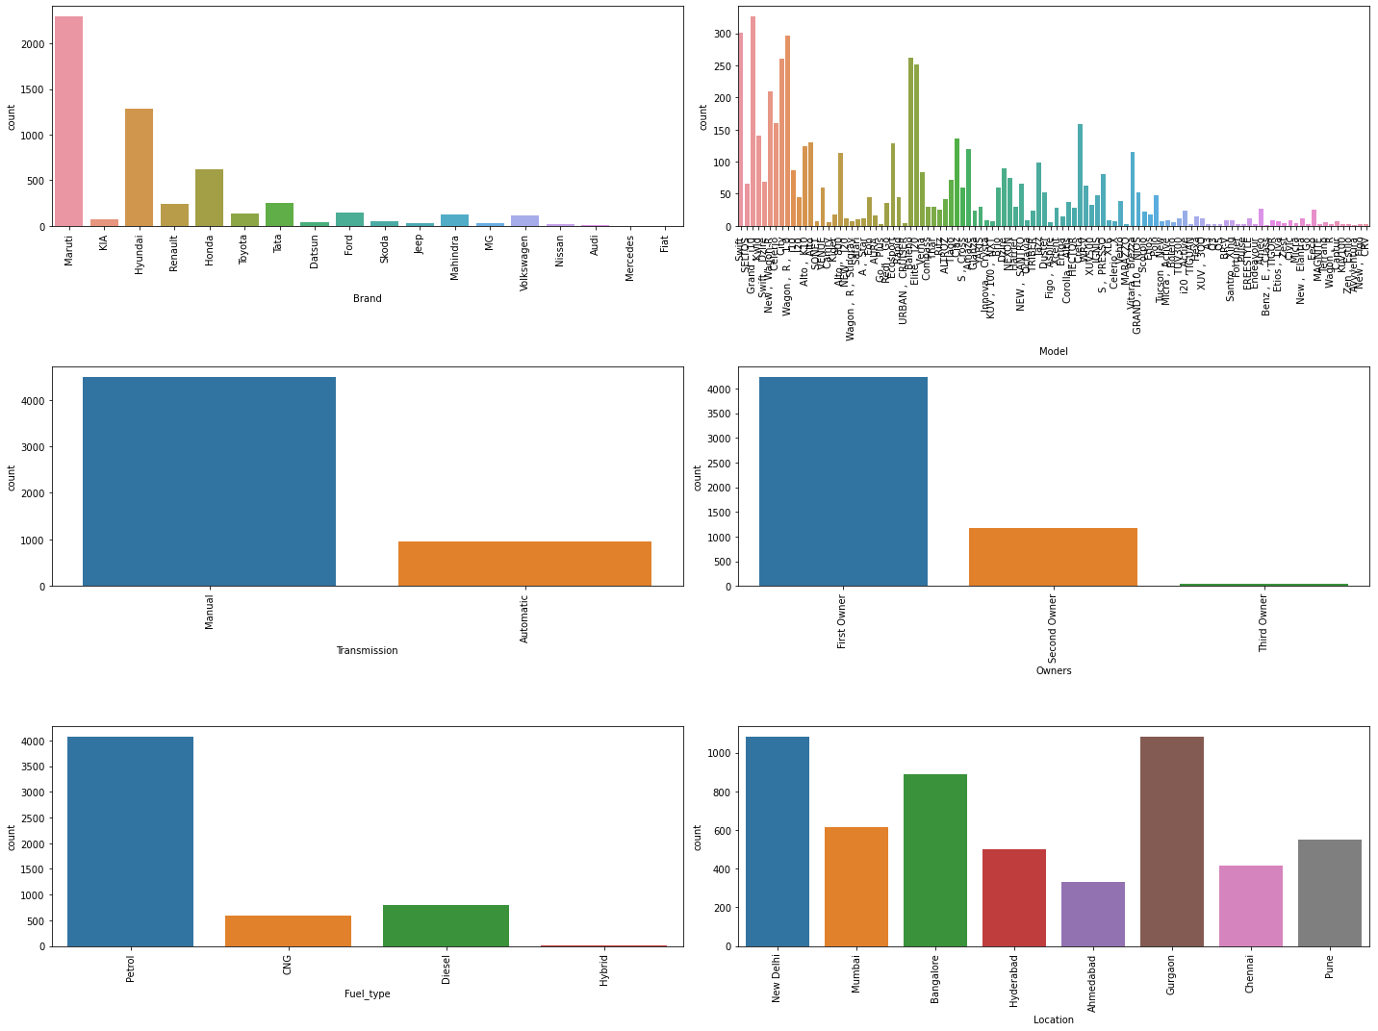
Visualization Cont..
By looking at the plots we can see that:
In column Brand, we can see that most of the cars are from brand Maruti.
In column Model, we can see that most of the models of the cars is Grand i 10.
In column transmission, we can see that most of the cars have gear type manual.
In column owners, we can see that most of the cars have single owners.
In column fuel_type, we can see that most of the cars have petrol as fuel type.
In column location, we can see that most of the cars are from location New Delhi and Gurgaon.
Count Plots

Slide 13
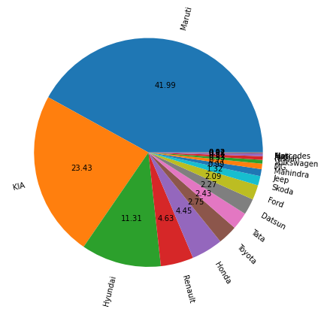
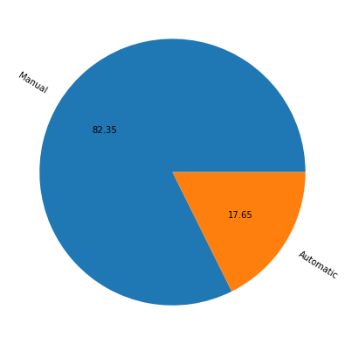
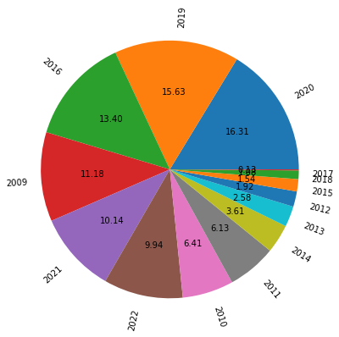
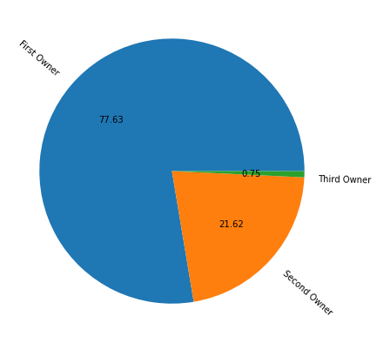
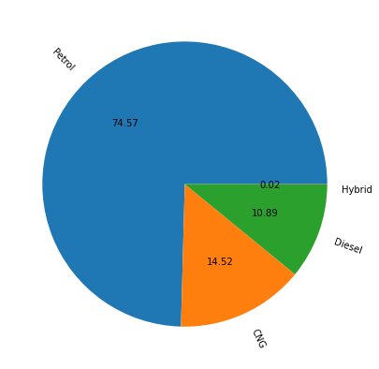
Visualization Cont..
1
2
Pie Plots
3
4
By looking at the plots we can see that:
In the above plot we can see clearly see that most of the cars from brand Maruti followed by KIA and Hyundai.
In the above plot we can see that most of the cars was having gear type as manual.
In the above plot we can see that most of the cars were from year 2020 followed by 2019 and 2016.
By looking at the plot we can see that most of the cars was owned by single owners.
By looking at the above plot we can see that most of the car was having fuel type as petrol followed by CNG and Diesel.
5

Slide 14
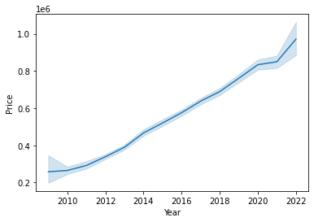
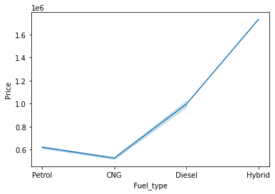
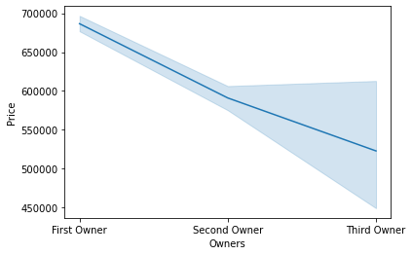
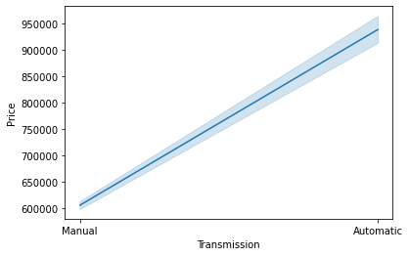
Visualization Cont..
By looking at the above plots we can clearly see that as the date/year of the car is closed to the present date/year, the price is more, so we can see in the plot that as the years starts coming close to the present year the price of the car starts increasing.
In this plot we can see that as the owners starts increasing the price of the car starts decreasing.
In this plot we can see that CNG used fuel car have low price and Hybrid cars have more price compared to petrol and diesel used cars.
Line Plots
In this plot we can see that the car having automatic gear type have more price than that of manual used gear type.

Slide 15
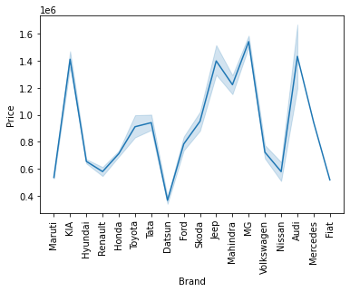
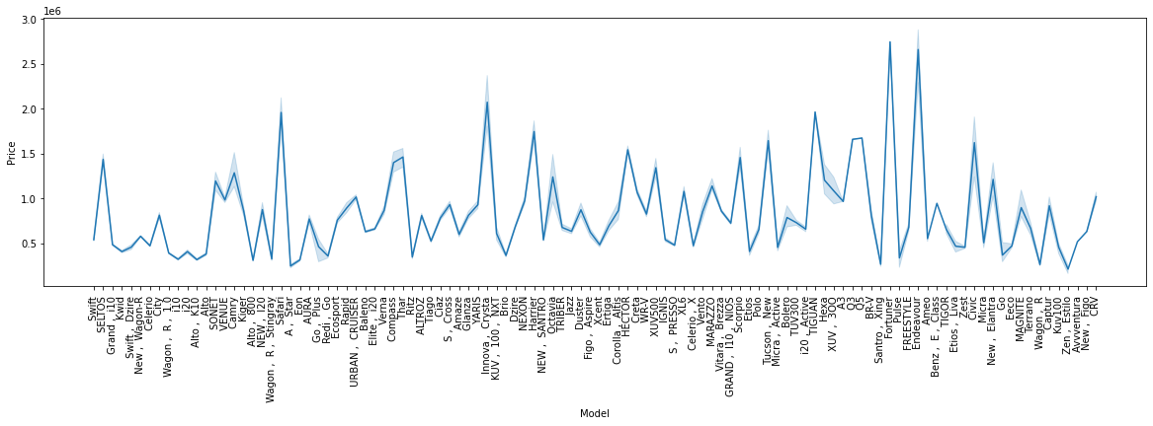
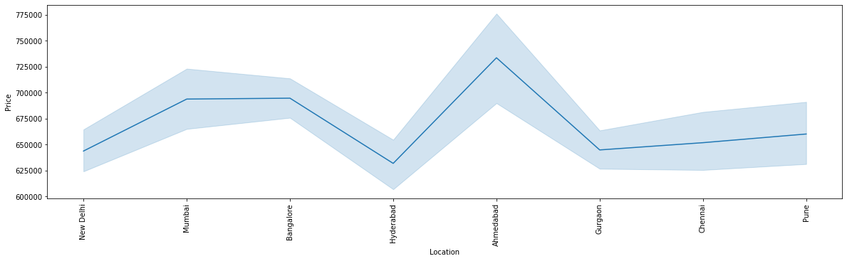
Visualization Cont..
In this plot we can see that the price fluctuates according to the brands, so in this we can see that MG brand have the highest price.
In this plot we can see that cars from location Ahmadabad have high prices as compared to other locations.
In this plot we can see that Fortuner and Endeavour models have high price than that of other models.
Line Plots

Slide 16
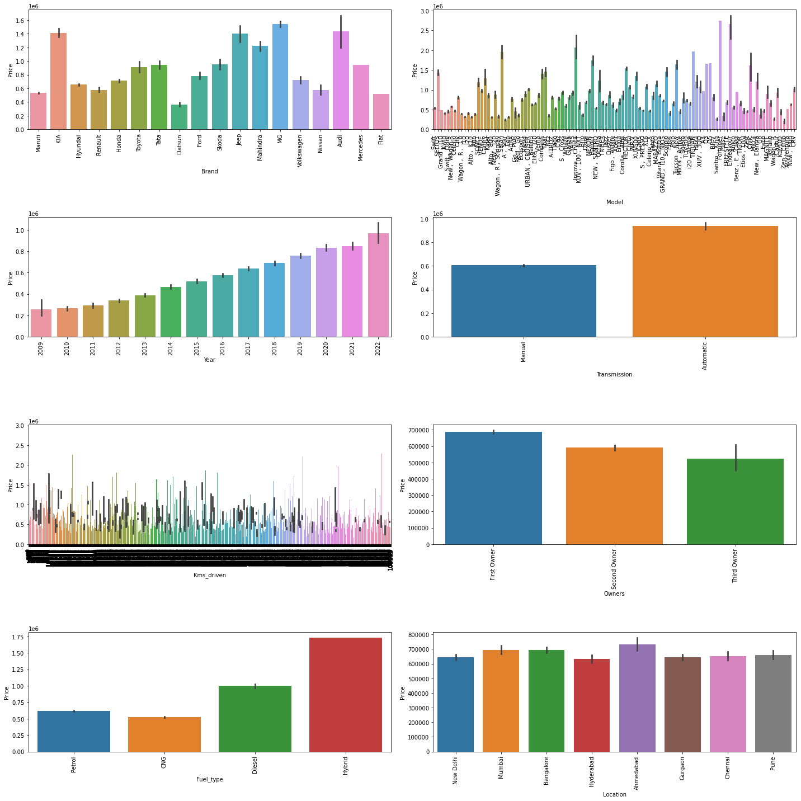
Visualization Cont..
By looking at the plots we can see that:
In the plot brand vs price we can see that the price fluctuates according to the brands, so in this we can see that MG brand have the highest price.
In the plot model vs price we can see that Fortuner and Endeavour models have high price than that of other models.
By looking at the above plot year vs price we can clearly see that as the date/year of the car is closed to the present date/year, the price is more, so we can see in the plot that as the years starts coming close to the present year the price of the car starts increasing.
In the plot transmission vs price we can see that the car having automatic gear type have more price than that of manual used gear type.
In the plot owners vs price we can see that as the owners starts increasing the price of the car starts decreasing.
In the plot fuel vs price we can see that CNG used fuel car have low price and Hybrid cars have more price compared to petrol and diesel used cars.
In the plot location vs price we can see that cars from location Ahmadabad have high prices as compared to other locations.
Bar Plots

Slide 17
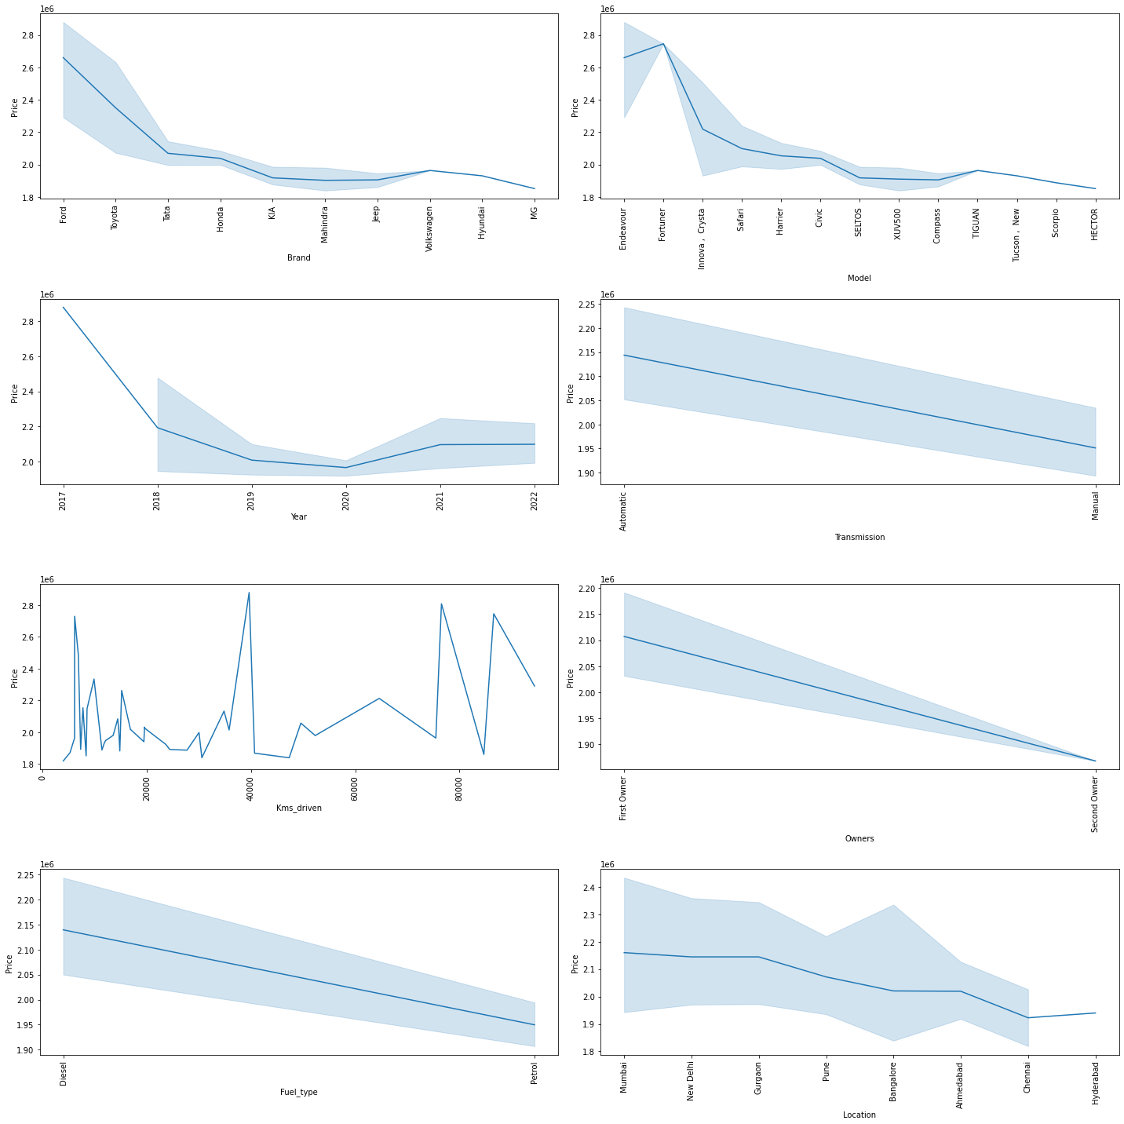
Visualization Cont..
By looking at the plots we can see that:
So in plot brand vs price we can see that brand Ford has the highest price among other brands.
In plot model vs price we can see that model Endeavour have the highest price among other models.
In plot fuel type vs price we can see that diesel cars have more price than the petrol cars.
Top 50 highest priced cars Line Plots:

Slide 18
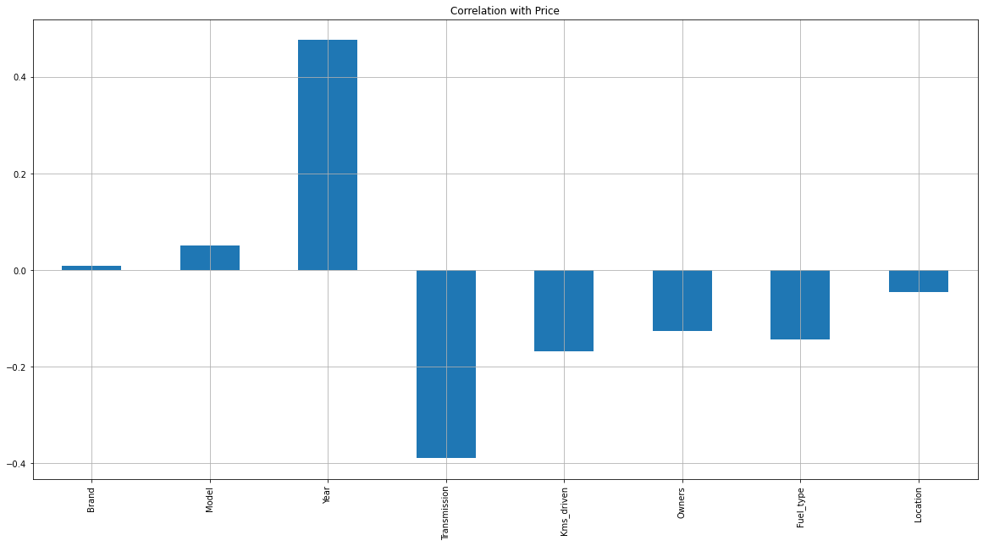
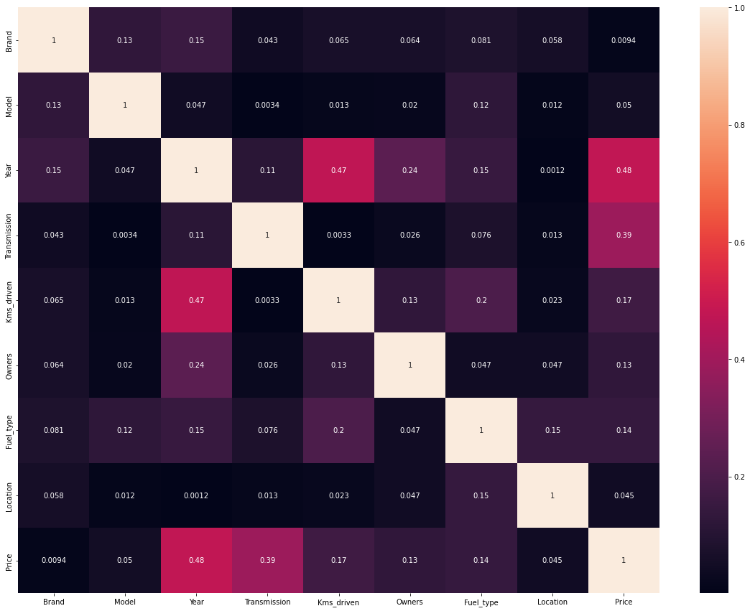
Correlation Between Features And Label
Bar Plot
HeatMap
By looking at the bar plot we can see that features are positively as well as negatively correlated with the label.
By looking at the heatmap we can see if there is any multicollinearity problem between the Features.

Slide 19
Data Analysis Steps Done
Encoded the categorical column data by using Lable Encoder.
To visualize the correlation between the Features and Label and multicollinearity problem i have used bar plot, line plot and heatmap.
Used Box plot to check whether there are outliers present or not in continuous data columns. Further found that in two columns outliers were present which were later on removed by using z-score method.
Skewness was checked and found that in one column skewness was present so later on it was treated with the help of power transform method.
Used Standard Scaler method to standardize the data.
Split, Train and Test to build the machine learning model. Found best random state and accuracy.

Slide 20
Model Building
Since ‘Price’ is my target variable which is continuous in nature, so that we came to know that it is regression type problem.
After the pre-processing, data cleaning and feature selection method I left with 9 columns including target. The algorithms used on training the data are as follows:
1.Xtreme Gradient Boosting Regressor (XGB)
2.Gradient Boosting Regressor
3.Ada Boost Regressor
4.Random Forest Regressor
5.Decision Tree Regressor
6.KNeighbors Regressor

Slide 21
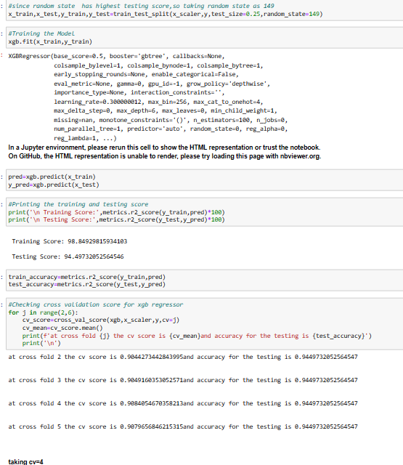
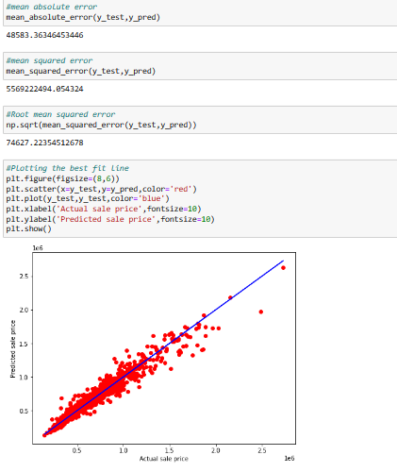
Xtreme Gradient Boosting Regressor
Created XGB Regressor model and checked for its evaluation metrics. The model is giving testing score as 94.49%.
From the graph we can observe how our model is mapping and also we can observe the straight line which is our actual dataset and dots are the predictions that the model has given.

Slide 22
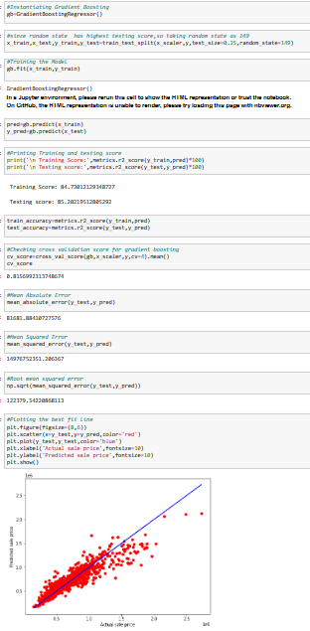
Gradient Boosting Regressor
Created Gradient Boosting Regressor model and checked for its evaluation metrics. The model is giving testing score as 85.28%.
From the graph we can observe how our model is mapping and also we can observe the straight line which is our actual dataset and dots are the predictions that the model has given.

Slide 23
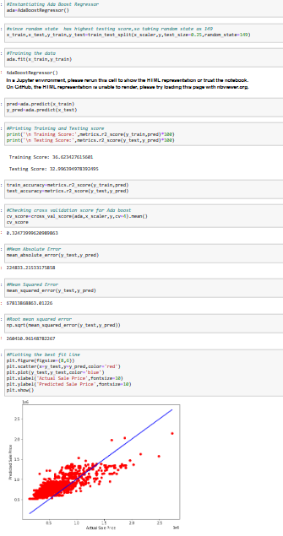
Ada Boost Regressor
Created Ada Boost Regressor model and checked for its evaluation metrics. The model is giving testing score as 32.99%.
From the graph we can observe how our model is mapping and also we can observe the straight line which is our actual dataset and dots are the predictions that the model has given.

Slide 24
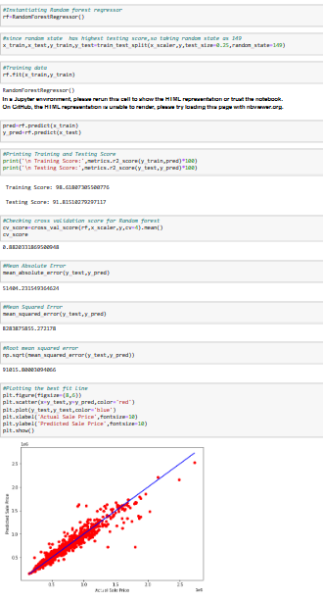
Random Forest Regressor
Created Random Regressor model and checked for its evaluation metrics. The model is giving testing score as 91.81%.
From the graph we can observe how our model is mapping and also we can observe the straight line which is our actual dataset and dots are the predictions that the model has given.

Slide 25
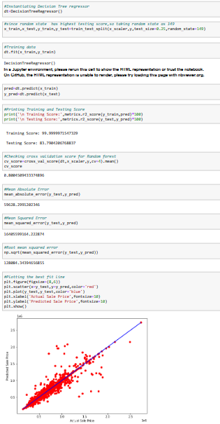
Decison Tree Regressor
Created Decision Tree Regressor model and checked for its evaluation metrics. The model is giving testing score as 83.79%.
From the graph we can observe how our model is mapping and also we can observe the straight line which is our actual dataset and dots are the predictions that the model has given.

Slide 26
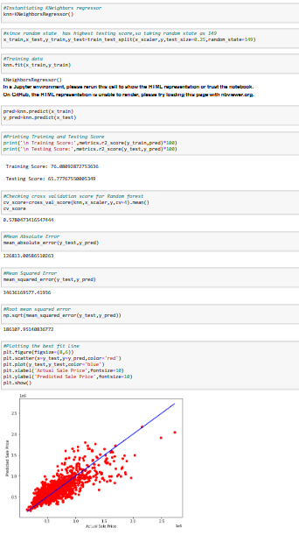
KNeighbors Regressor
Created KNeighbors Regressor model and checked for its evaluation metrics. The model is giving testing score as 65.77%.
From the graph we can observe how our model is mapping and also we can observe the straight line which is our actual dataset and dots are the predictions that the model has given.

Slide 27
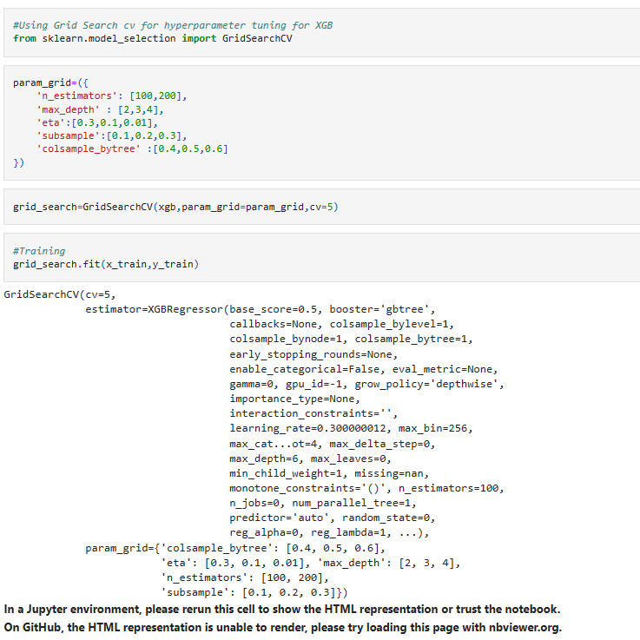
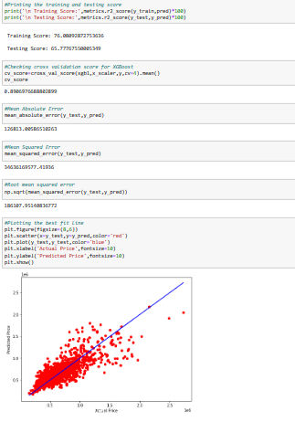
Hyperparameter Tuning And Creating Final Model
I have used Grid Search CV to tuned the model and get the best parameters of XGB Regressor. And after getting the best parameters used that for building final model to get the best accuracy.
After performing hyper parameter tuning using best parameters of XGB Regressor, the training,testing and cross validation scores reduced.So I am saving the model on which hyper parameter tuning was not done.

Slide 28

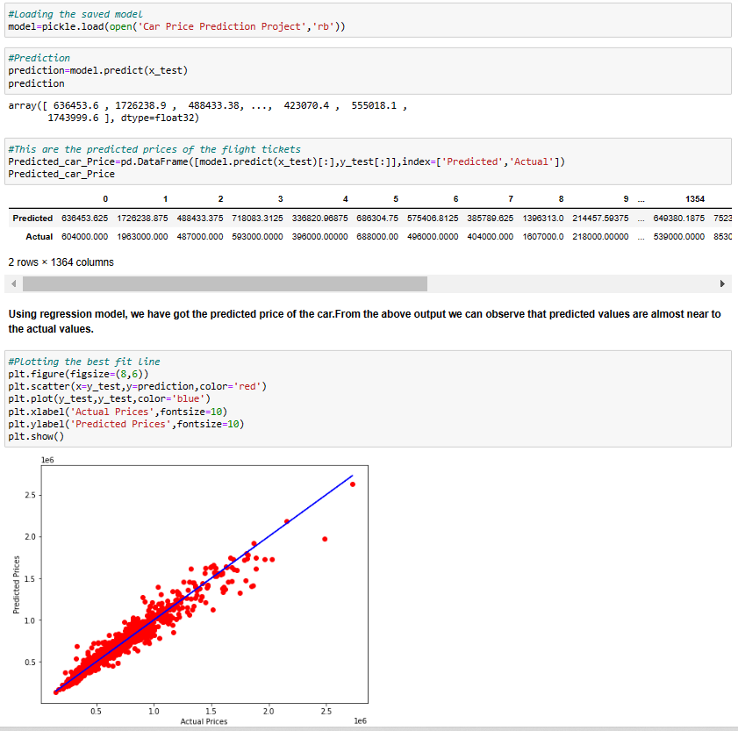
Saving The Model And Prediction From Saved Model
I have saved my final best model using pickle library and loaded saved model for predictions.
Using regression model, we have got the predicted price of the used cars. From the above output we can observe that predicted values are almost near to the actual values.
The graph shows how our model is mapping and the plot gives the linear relation between predicted and actual price of the used cars. The blue line is the best fitting line which gives us the actual values/data and red dots gives us the predicted values/data.

Slide 29
Conclusion
The case study aims to give an idea of applying machine learning algorithms to predict the price of the used car. After the completion of this project, we got an insight of how to collect data, pre-processing the data, analyse the data, cleaning the data and building a model.
In this we have used 6 learning models to predict the price of the used cars.
From our detailed analysis we can determine the following:
Year and transmission was having some strong relationship with the label that is Price.
Car Brand is having highest price among all the other brands.
Car model Endeavour is having high price among all the other model.
Cars having fuel type as hybrid are having highest prices.
Cars having gear type as Automatic are having high prices as compared to others.
Cars which are located at Ahmadabad are having high prices as compared to other locations.

Slide 30
THANK YOU！

